Slide 1
Creativity & Innovation
BM006-3-2-CRI (VC1) 1st April 2018
Lecture 10:
Technical entrepreneurship

Slide 2
Topic Learning Outcomes
To evaluate critically the appropriateness of different approaches to technical entrepreneurs.

Slide 3
Outline
On entreprenuership and marketing
The innovation process
Intellectual property rights
University research and technology transfer
Intellectual property rights and development
Technology adoption and diffusion
Marketing and adoption

Slide 4
Entrepreneurship
    Entrepreneurs make things happen.
They are individuals who take a concept and convert it into a reality. A product, policy or institution.
They become the champions of a new process, and they are engines of change.
Entrepreneurship occurs in all areas of life. In business, academy, government and Ngos.
Entrepreneurs are everywhere, in Wall street and the Sahel.
Entrepreneurship can be used for good and evil. The Godfather was an entrepreneur that misused his talent.

Slide 5
Entrepreneurs Can Be Encouraged and Promoted
Openness to new ideas, freedom from investigation of operation, and promotion and pay based on merit encourage entrepreneurship.
Excessive regulation, rigid hierarchy, lack of freedom, and excess control discourage entrepreneurship.

Slide 6
Requirements of Entrepreneurs
Entrepreneurs need a keen eye to understand economic, social, and scientific realities and the capacity to understand evolutionary processes in the future.
They need to understand how institutions work, and individuals react in order to introduce activities and products that serve peoples’ need and that are sustainable economically and politically.
Entrepreneurs also need dedication and commitments and the capacity to overcome failure.

Slide 7
Entrepreneurship and society
To encourage entrepreneurship, society should tolerate failure and give people a second chance. .
Obviously, people need to pay for their mistakes, but if the payment is too high, people will not be daring or take risks.
Effective legal system is essential for positive entrepreneurship

Slide 8
Marketing & environmental leadership
A leader may have to sell ideas, promote concepts, raise funds, recruit followers-which requires marketing.
Frequently,Environmental issues are abstract and removed from the daily reality f most people- marketing environmental issues is a challenge.

Slide 9
What Are Innovations?
Innovations are new ways to achieve tasks.
Types of innovations include:
  Mechanical—tractors, cars.
  Chemical—pesticides.
  Biological—seed varieties.
  Managerial—IPM, extra pay for work, overtime.
  Institutional—water users’ association, patents, banks, stock market, conservation districts, monks.
It is useful to distinguish between process innovations (new biotechnology procedures) and product innovations (Bt cotton).

Slide 10
The Innovation Process
An innovation starts as a concept that is refined and developed before application.
Innovations may be inspired by reality. The innovation process, which leads to useful technology, requires:
  Research
  Development (up-scaling, testing)
  Production
  Marketing
  Use
Experience with a product results in feedback and leads to improved innovations.

Slide 11
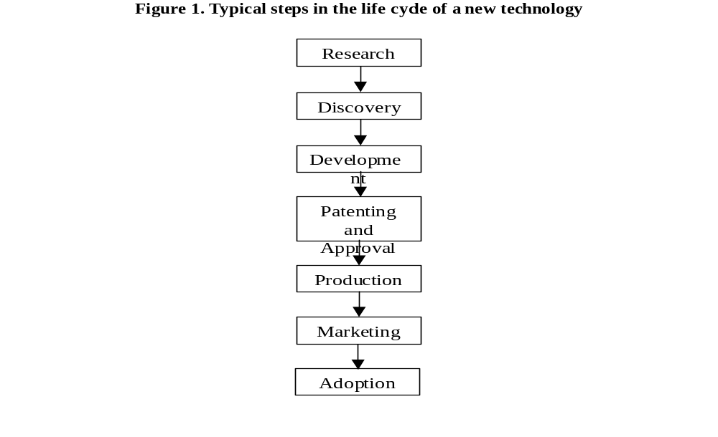
The Innovation Process

Slide 12
Technology Adaptation and Appropriateness
Rarely is the same technological solution optimal everywhere. The value of an innovation depends on socio-economic,climatic, and ecological specifics.
Important innovative activities adapt technological solutions to specific conditions.
  Export of technologies across regions without adaptation may lead to negative environmental side effects and waste.
A technology may have several versions to meet needs and capabilities of various users in a region, e.g., large vs. small farmers’ versions of a machinery.
The establishment of an innovative capability starts with a buildup of capacity to support and adopt innovations and new technologies.

Slide 13
Induced Innovations
Innovations respond to need and economic conditions. Inventors, investors, and researchers put effort into solving burning problems, and that leads to innovations.
  Labor shortages led to mechanized equipment.
  Drought conditions led to improved irrigation.
  Energy crises led to higher efficiency cars.
  Farmers’ cooperatives were established during periods of excessive low farm prices.
Environmental regulations trigger cleaner technologies.
  A tax on carbon will lead to improved stoves and power plants.

Slide 14
Various Types of Innovators
In the past most innovations were introduced by practitioners. Even now practitioners are important innovators. They identify a way to meet needs.
The scientific discoveries of the late 19th century gave rise to science-based innovations (Edison, Bell, Marconi).
Major companies (IBM, Sony, Bell, Kodak, GM) built their own research labs.
Public sector labs made important agricultural and environmental discoveries.
Universities and start-up companies are becoming major sources of new innovations. The ownership of a technology and leadership in its applications move between organizations over time.

Slide 15
Incentives for Innovations
Patents: Awards monopoly rights for 17-20 years.
  Patent protection allows publication of research findings that leads to innovations.
  Patent rights (for certain applications) can be transferred.
  Patents are valid only where they are registered.
Copyright protection: Pertains to books, brand names, and the media.
Trade secrets: Protects against thefts.
Plant breeders’ right: Allows exclusive sales of varieties and allows farmers to reuse seeds.
Prizes: Awarded to winners of a contest for finding a technical solution to a problem.
Indigenous knowledge is poorly protected.

Slide 16
Intellectual Property Rights and Development
Investments in R&D and new products will be much lower without the expected monopoly gains.
Local industry and foreign investors benefit from patent protection, as is already the case in India.
IPR constraints may inhibit domestic companies’ ability to develop new products.
Added IPR knowledge may lead to gains:
  Production for local markets does not require obtaining rights to patents that are not registered locally.
  Developing countries can trade access to bio-diversity for access to technology. They can reach special agreements with universities and companies.

Slide 17
Investment in Research: A Key Element of Environmental Policies
Research enables discovery of basic environmental problems. Without research, not much would have been known about the link between smoking and cancer.
Research provides better monitoring and management equipment to help identify environmental problems and monitor response.
Public research enables sustaining development of technologies that may not be economical under existing prices.

Slide 18
Division of Labor
Basic research: Gain more comprehensive knowledge or understanding of the subject under study, without specific applications in mind. Conventionally conducted by universities.
Applied research: Apply knowledge. Often conducted by industries.
Educational-industrial complex: University research has led to the creation of new firms and even industries, brought old ones down, and, in general, profoundly impacted rates of innovation in the larger economy.

Slide 19
Stakeholders in the
Innovation Process
Universities, including research scientists, university administrators, and designated officers of technology transfer.
Entrepreneurs, including start-up companies and venture capitalists.
Incumbent corporations.
Potential technology adopters and downstream producers who will use the technology
Government regulators.
Environmental and other special interest organizations.
Consumers.

Slide 20
Why Universities Do Not Do What Companies Do and Why Companies Do Not Do What Universities Do
1. Uncertainty: Uncertain outcome of basic research.
2. Inappropriability or ‘nonmarketability’: Some results from basic research are not appropriable, because they occur at such fundamental levels of scientific analysis.
3. Spillovers: Some results from basic research can easily spill over to competitors in the same line of business that the results may actually help the competitors more than they help the company that conducted the initial research.

Slide 21
Institutional Arrangements: Incentives to University Researchers
Formulas for the allocation of OTT revenues from license royalties:
-Most common formula: Equal sharing among the university (33%), the department (33%), and the employee inventor (33%).
-Another common formula: 50%-50% sharing between the university and the inventor.
-Average net revenue distributions: University (35%), department (25%), and faculty inventor (40%).

Slide 22
Adoption and Diffusion
The use of new technologies spreads gradually.
There is a significant time lag between the time a new innovation is introduced and when it becomes widely used by producers or consumers.
Diffusion is the aggregate process of product penetration.
  It is measured by the percentage of potential users who actually adopt a technology.
Diffusion curves measure aggregate adoption as a function of time. They tend to be S-shaped.
Adoption is a decision by a specific individual to use a technology. Diffusion is aggregate adoption.

Slide 23
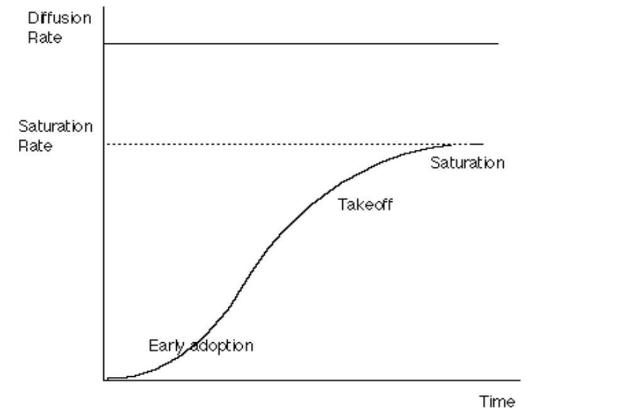
The S-Shaped Diffusion Curve

Slide 24
Stages of Diffusion
We distinguish among:
  Early adopters: More educated, innovative individuals who gain from technology.
  Followers: The majority of adopters who see its success and want to join in.
  Laggards: Less-advanced individuals who either do not adopt or adopt very late and may lose because of the technology.

Slide 25
Adoption as Imitation
Some explain the S-shaped behavior as the outcome of imitation.
Contact among individuals is the driving force of diffusion.
Profitability of the new technology, ease of use, and quality of technical support are factors that can enhance diffusion.
VCRs, wireless communication, Bt cotton, and Viagra were technologies with a fast rate of diffusion, while personal computers and IPM had slower adoption rates.

Slide 26
Threshold Model
The factors behind diffusion:
  Heterogeneity of potential adopters.
  The individual decision process aimed at improving well-being.
  Dynamic forces that make technology more attractive.
Source of heterogeneity (size, location, land quality, and human capital).
Decision criteria (profitability, well-being, risk minimization).
Dynamic processes that drive adoption (learning by doing, learning by using, network benefits).

Slide 27
Other Examples
Water-conserving technologies (sprinklers) increase water-use efficiency if:
  With traditional technology, 50% of applied water is actually consumed.
  75% is consumed with sprinklers.
  It results in higher yield and water saving.
Technology adoption occurs:
  In sandy soils and hills where the traditional technology is especially inefficient.
  Locations where the price of water is high.
  With high-value crops.
Green Revolution technologies are high-yield varieties that require complementary inputs (fertilizers and sometimes water). They are adopted when:
  They have high yield and cost effects.
  Farmers have access to credit.

Slide 28
Adoption and Risk
Impacts of technologies are unknown. Risk considerations slow adoption.
One approach in assessing a technology:
  Maximize Expected benefits-α risk
    where α is a coefficient of risk aversion.
    Risk may be measured by a variance of profit.
Policies that reduce risk include
  insurance (crop insurance enhances adoption)
  Diversification.
An alternative approach: Select the technology with the highest benefit given that it yields minimum required benefits at the worst case scenario. This approach aims to assure sufficient resource during drought.
Good inventories, banking systems, and asset accumulation possibilities reduce the need for protection against risks.

Slide 29
Adoption, Credit, Location, and Education
Lack of credit and high cost of credit are major impediments for adoption.
Poorer consumers and farmers may be more constrained by risk and credit constraints.
Adoption may be slower at far away locations because of less access to information and sources of technology, higher cost of inputs. In some cases, however, early adopters are at distance locations(if technology reduces transportation costs).
Adoption requires a high learning cost -more educated individuals tend to be early adopters. When the technology is simple,sometimes less sophisticated individuals adopt first.

Slide 30
Adoption and Policy
The government may enhance adoption through positive incentives such as:
  Price support of products produced with technologies.
  Extension and education.
  Credit subsidies.
  Insurance schemes.
  Cost-sharing arrangements.
Negative incentives
  Regulation against existing technologies (pesticide regulation enhances biotechnology).
  Higher cost of inputs used intensively with existing technologies (water price hikes).
Key elements of environmental policy are incentives to
  Induce innovation of greener products.
  Induce adoption of cleaner products.

Slide 31
Timing of Adoption
Sometimes it is worthwhile to wait and see and not adopt immediately when benefits of technology exceed costs.
Cost of technology may decline over time. You should wait if the reduction in technology cost> than the cost of waiting.
When a technology has uncertain irreversible outcomes- waiting to learn more is prudent.
Waiting prevent the opportunity of learning and improving a technology- the gains from waiting should be compared to the costs.

Slide 32
Government & adoption
Governments and Ngo’s are promoting and encouraging adoption of technologies
Government is using incentives, initiate advertisement and promotional campaigns.
Extension is an institution used for education and support of diffusion processes.
  Extension should complement private sector marketing of new technology -not replace it.
  In some cases extension’s clientele are mostly technology providers-not users
  Extension role is to provide balanced assessments of new technologies not advocate them.
  Extension role is adaptation of technology
  Extension may initiate and implement institutional innovations

Slide 33
Question and answer session
Q & A
Slide <<number>> of 13

Slide 34
What we will cover next
Process of innovation
Slide <<number>> of 13

Slide 35
Activities
In what ways do technological entrepreneurs differ from entrepreneurs in general?
What is venture capitalist and what part do they play in technological entrepreneurship?
Distinguish between the different types of technological entrepreneur.

